Slide 1
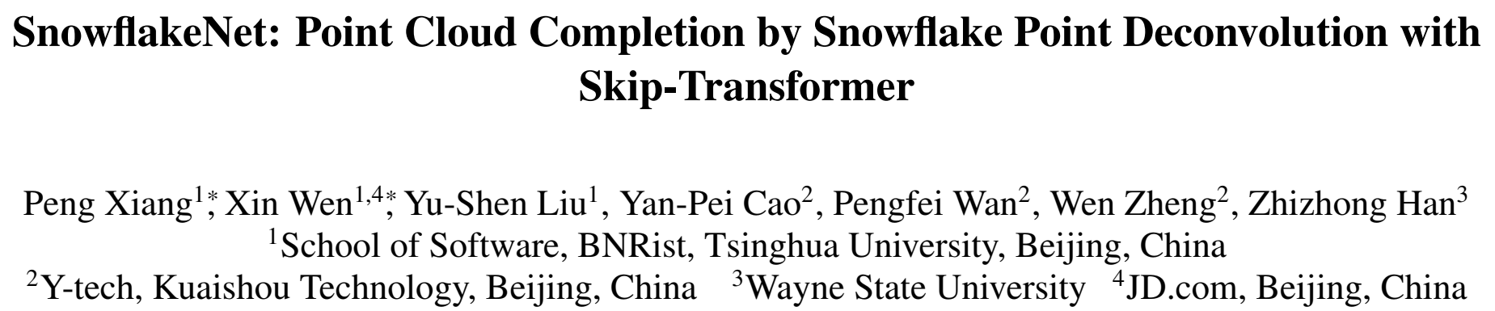
2021.10.17 程志华

Slide 2
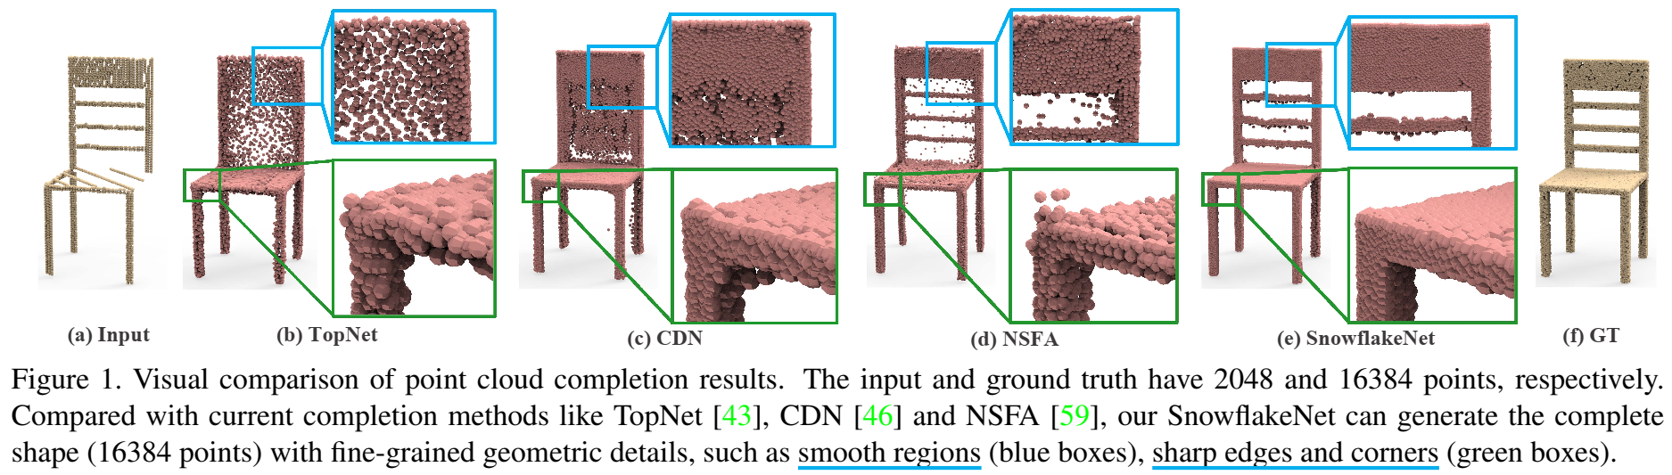
SnowflakeNet
Existing methods:
suffered from discrete nature of point cloud and unstructured prediction of points in local regions, which makes it hard to reveal fine local geometric details on the complete shape.
It is challenging to capture the local geometric details and structure characteristic in local patches, such as smooth regions, sharp edges and corners.
Notes:
光滑的表面，均匀的点分布，规整的边缘

Slide 3
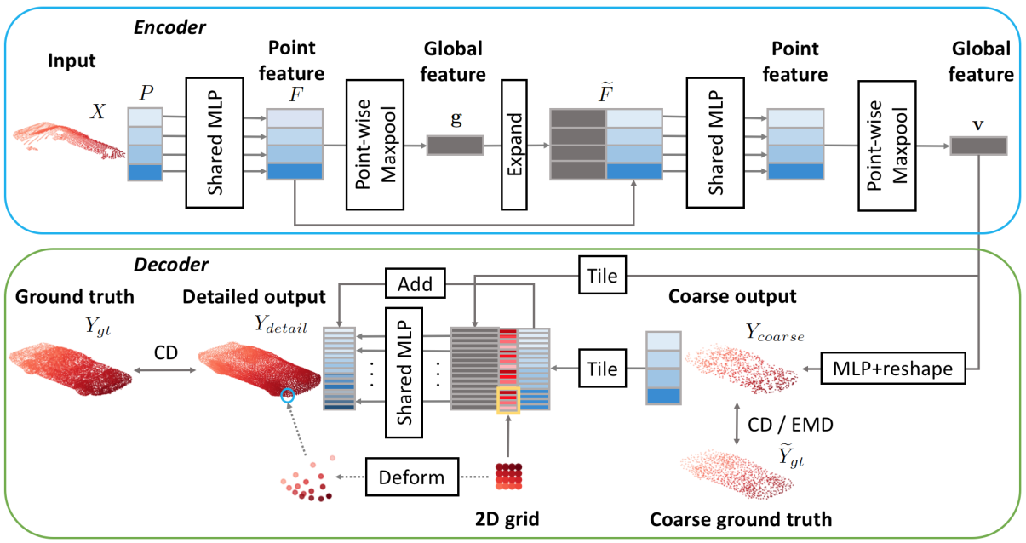
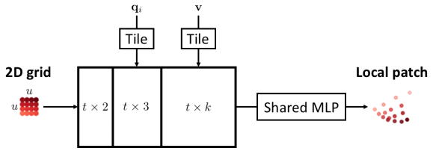
SnowflakeNet
Coarse-to-Fine manner
Folding-based method
Notes:
the folding operation samples the same 2D grids for each parent point, which ignores the local shape characteristics contained in the parent point

Slide 4
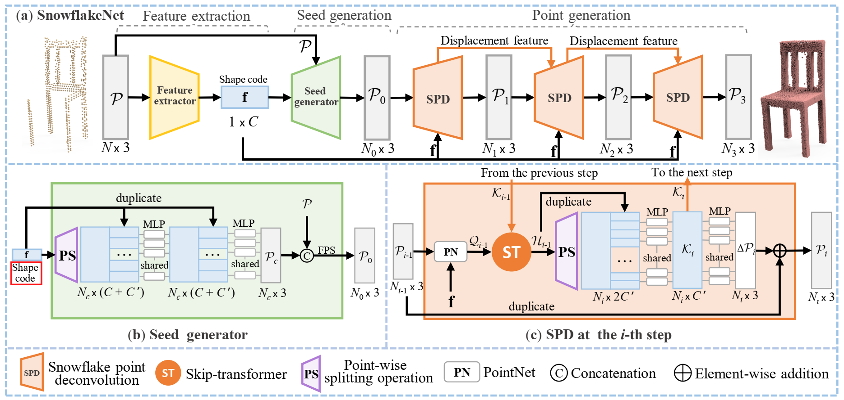
SnowflakeNet
Method
SnowflakeNet consists of three modules:
1)feature extraction, 2)seed generation and 3)point generation

Slide 5
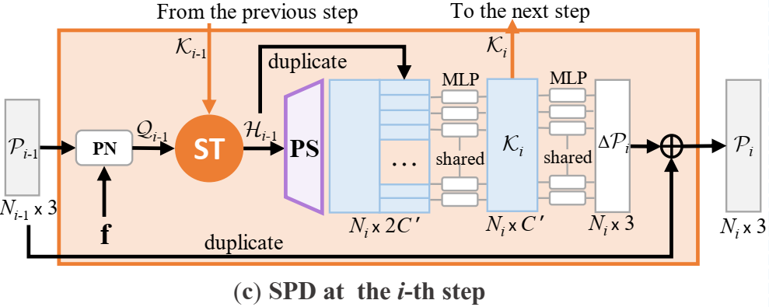
SnowflakeNet
Snowflake Point Deconvolution (SPD)
The SPD aims to increase the number of points by splitting each parent point into multiple child points, which can be achieved by first duplicating the parent points and then adding variations

Slide 6
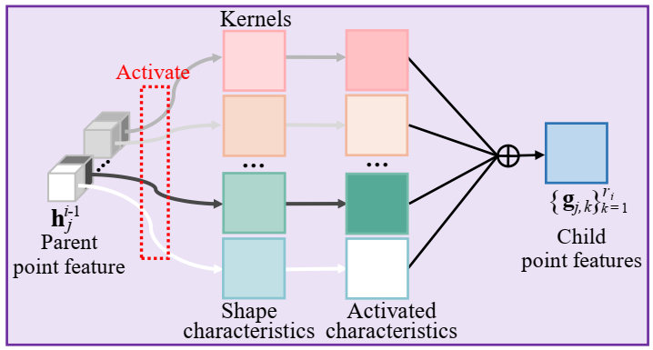




SnowflakeNet
Point-wise splitting operation
:
leverages the geometric information in parent points and adds variations that comply with local patterns
each learnable kernel indicates a certain shape characteristic, which describes the geometry and structure of 3D shape in local region. indicates the activation status of the m-th shape characteristic.
Notes:
the shape characteristic embedded by the parent point features is extracted and inherited into the child points through a point-wise splitting operation

Slide 7
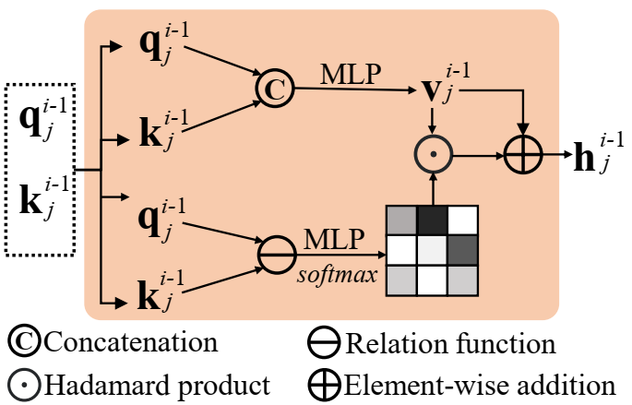
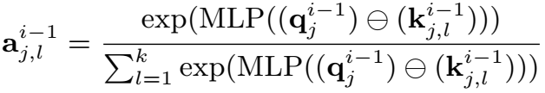
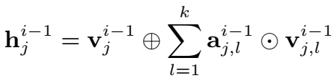
SnowflakeNet
Skip-Transformer
It learns shape context and spatial relationship between child points and parent point in local patches.
It serves as the cooperation unit between SPDs.
Notes:
skip-transformer is proposed to integrate the spatial relationships across different levels of decoding. Therefore, it can establish a cross-level spatial relationships between points in different decoding steps, and refine their location to produce more detailed structure

Slide 8
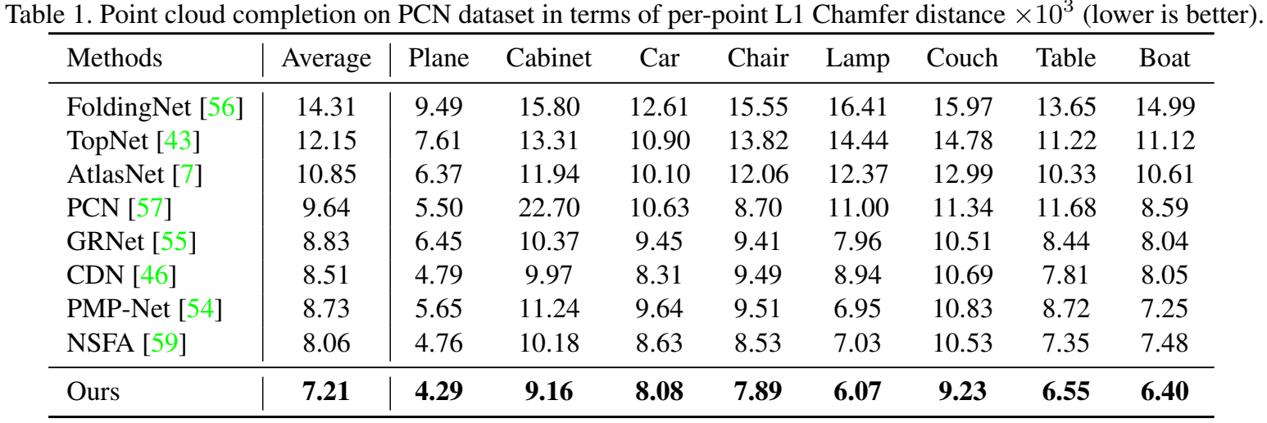
SnowflakeNet
Experiments
In PCN dataset

Slide 9
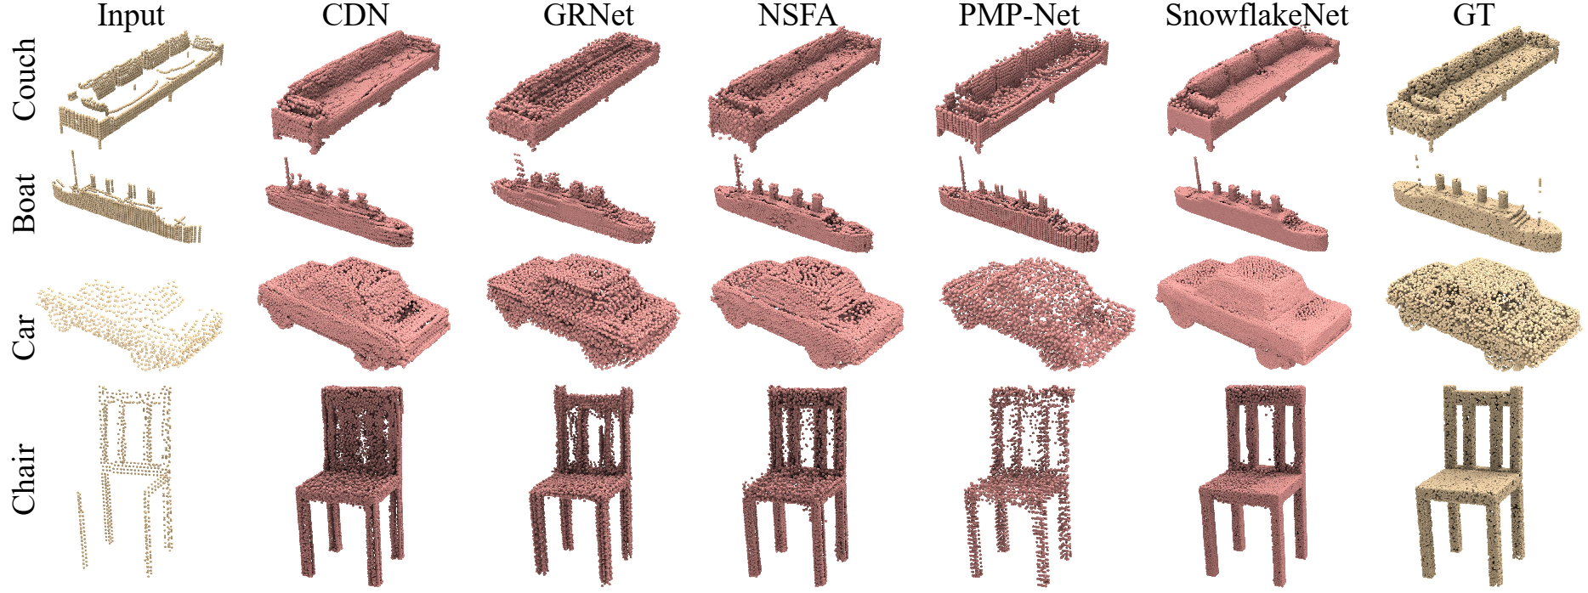
SnowflakeNet
Experiments
In PCN dataset

Slide 10
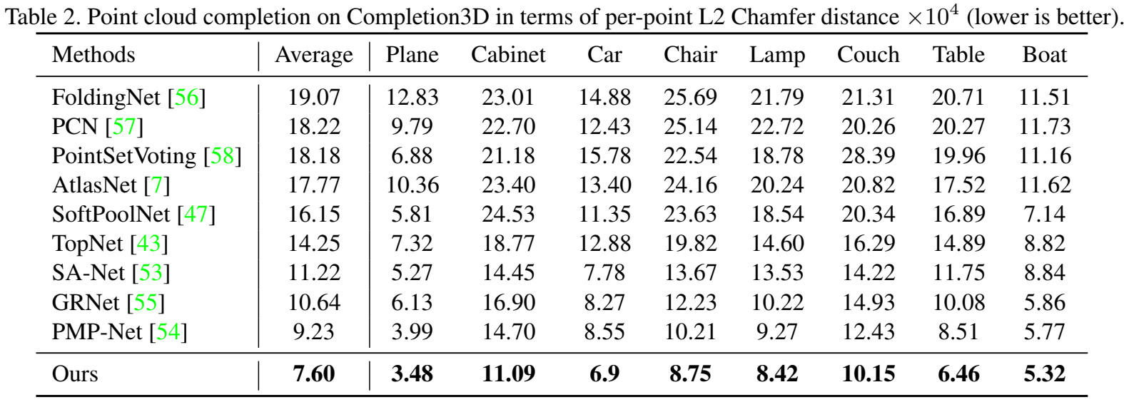
SnowflakeNet
Experiments
In Completion3D dataset

Slide 11
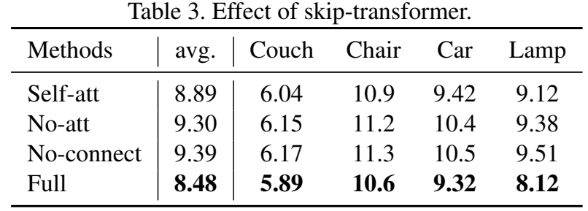
SnowflakeNet
Ablation Study
Effect of skip-transformer
Self-att: replaces the transformer mechanism in skip-transformer with the self-attention mechanism, where the input is the point features of current layer.
No-att : removes the transformer mechanism from skip-transformer, where the features from the previous layer of SPD is directly added to the feature of current SPD layer.
No-connect: removes the whole skip-transformer from the SPD layers, and thus, no feature connection is established between the SPD layers.

Slide 12
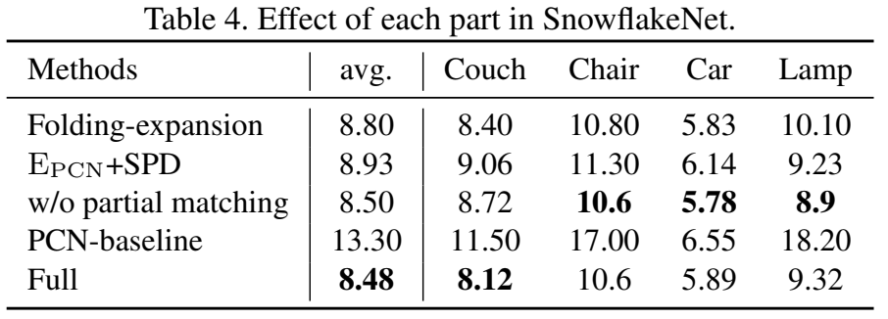
SnowflakeNet
Ablation Study
Effect of each part in SnowflakeNet.
The Folding-expansion variation replaces the point-wise splitting operation with the folding-based feature expansion method.
The E_PCN+SPD variation employs the PCN encoder and our SnowflakeNet decoder.
The w/o partial matching variation removes the partial matching loss.

